Slide 1


Facility Master Planning
Planning Committee Meeting #1
March 27, 2024

Slide 2
WELCOME & INTRODUCTIONS
Dr. Kory Kalahar, Superintendent
Welcome
Introduction of Committee
Background
Outcomes

Slide 3
COMMITTEE & BACKGROUND
Why long-range facility planning?
Why now?
Where are we as a district?
Budget realities…

Slide 4
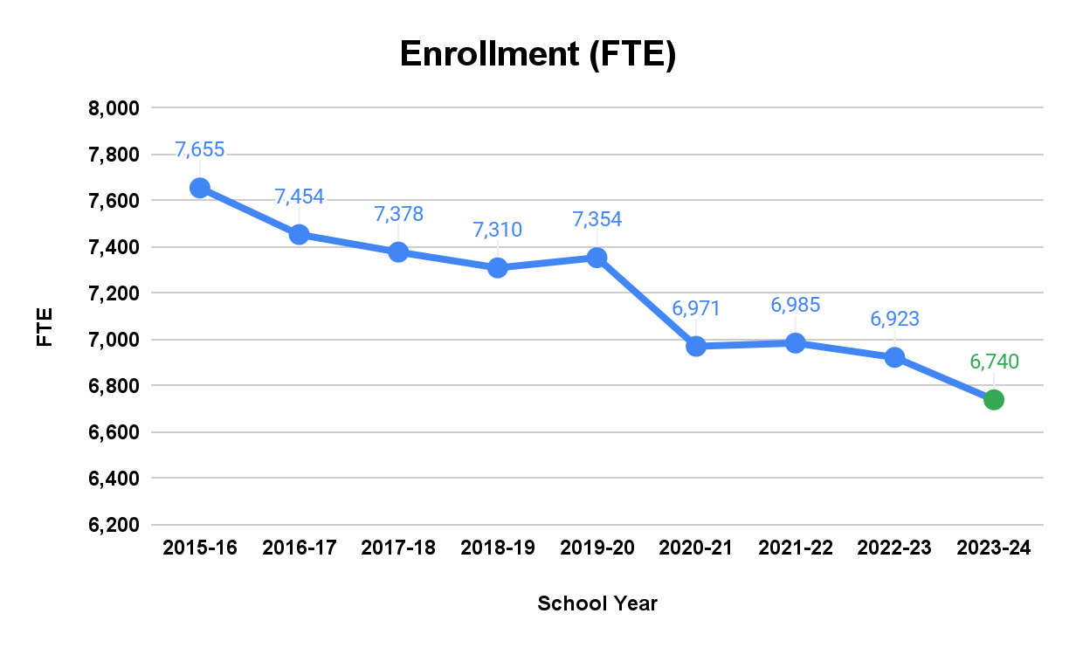
COMMITTEE & BACKGROUND

Slide 5
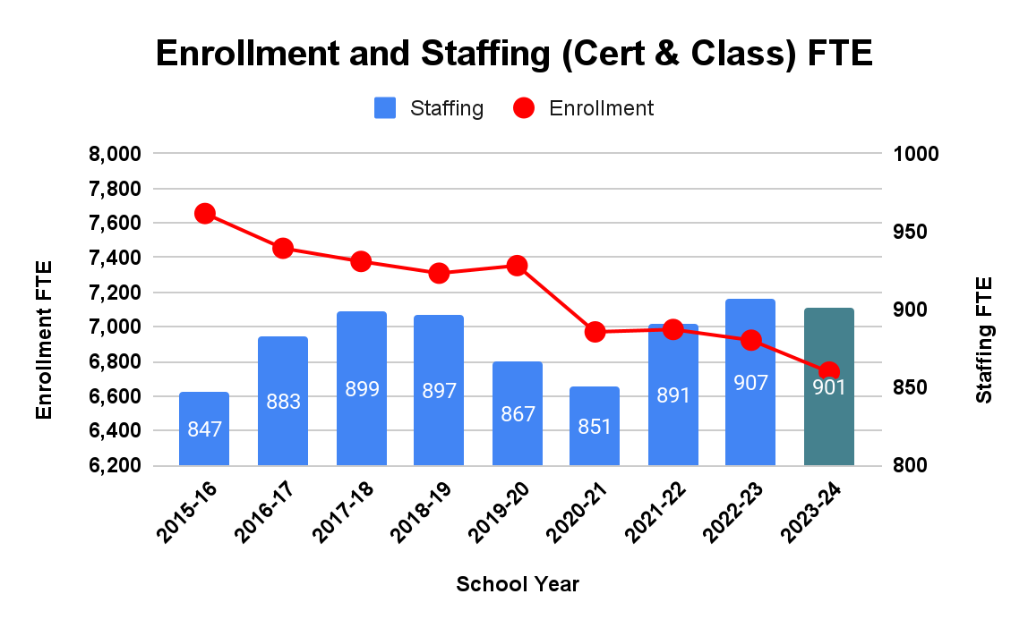
COMMITTEE & BACKGROUND

Slide 6
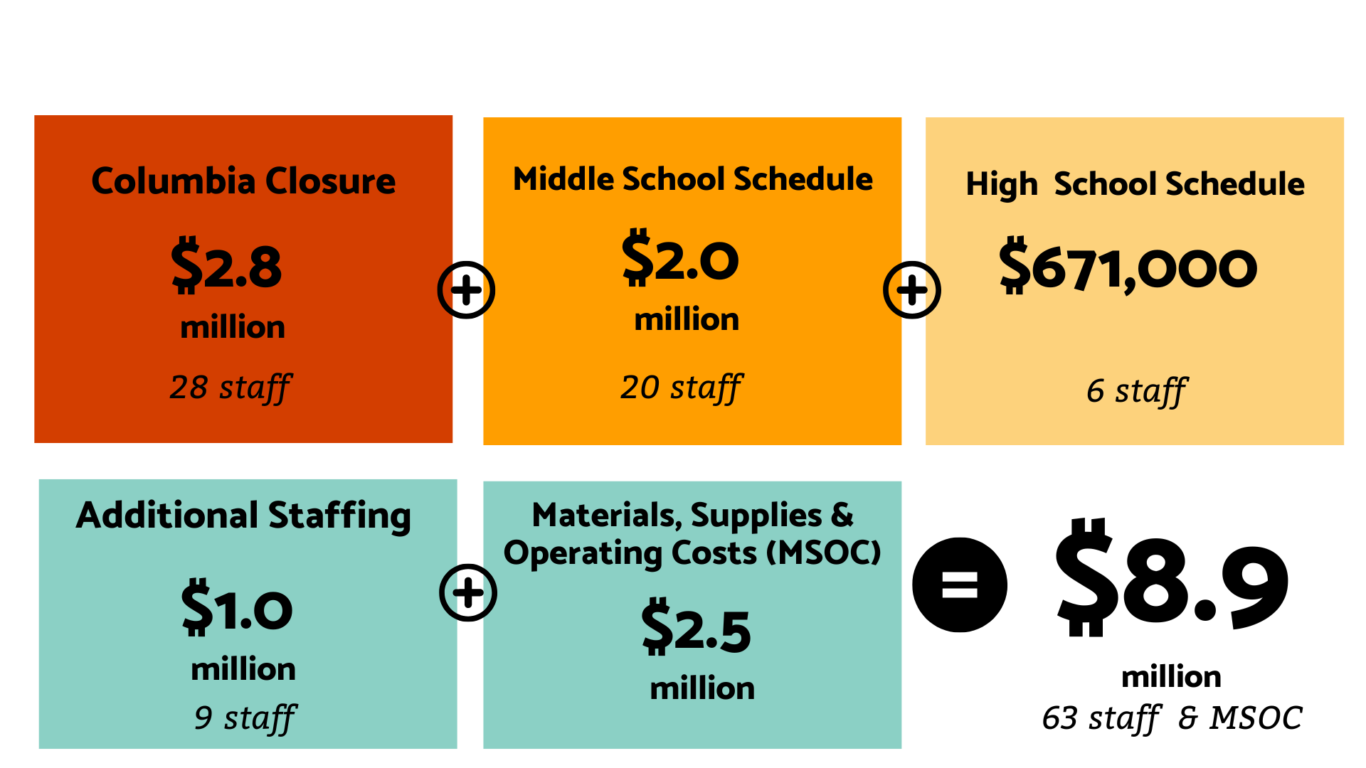
COMMITTEE & BACKGROUND

Slide 7





PURPOSE
Bring together a community-representative committee to review data and information:
Define facility needs, as determined by data and program, and prioritize solutions
enrollment | physical condition
capacity & utilization | functional adequacy
educational program

Slide 8
OUTCOME
A Long-Range Facility Plan
grounded in data and educational programming
meeting the needs of the students and families in the Wenatchee community.

Slide 9
SUMMARY OF WHY WE ARE HERE
Develop and agree on the core elements of a Long-Range Facilities Plan
  Driven by the District’s Educational Programming needs and the focus on student success
  Supported by Data and a shared understanding of that Data
  Incorporates existing facilities needs into overall plan
  Prioritizes projects defined within the Long-Range Facility Plan

Slide 10
PLANNING TEAM
Phil Crocker | Educational Facility Planner
David Beaudine Rob Gross Jonathon Miller | Construction Management & Planning
Meagan Garrett | Marketing and Communications

Slide 11

PLANNING PROCESS
1
2
3
4
Gather Data
Group Input and Data Processing
Long Range Facility Master Plan
Short & Long- Term Facility Improvements

Slide 12
FACILITY PLANNING DATA
Educational Programs
Enrollment Projections
Capacity Analysis
Utilization Analysis
Condition Reports
  Physical
  Functional

Slide 13
PLANNING ASSUMPTIONS
A long-term goal for the district is that all programs should be housed in permanent, adequate space
Secondary teachers will continue to “prep” in their classrooms
Educational spaces can be utilized for current and emerging district programs (e.g. project-based, CTE-infused programs)

Slide 14
EDUCATIONAL PROGRAMMING
A strong basic skills program (reading, writing, math, science, social studies, physical education, arts, etc.)
Elementary programs to assist students with individual needs (resource rooms, special education, ELL, enrichment, etc.)
After school activities (football, basketball, theatre arts, wrestling, track, volleyball, softball, etc.)
Career Technical Education (agriculture, business, health sciences, sports medicine, participation in skills center, etc.)
College Preparatory Programs (Running Start, College in the High School, CTE Dual Credit)

Slide 15
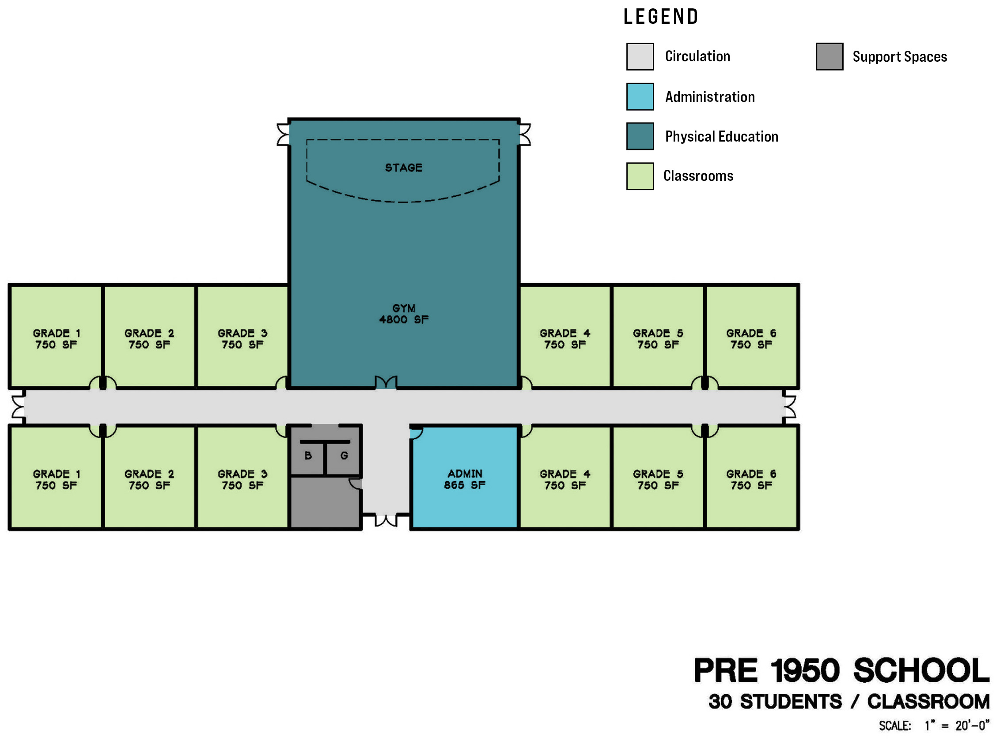
EVOLVING SCHOOL SPACES

Slide 16
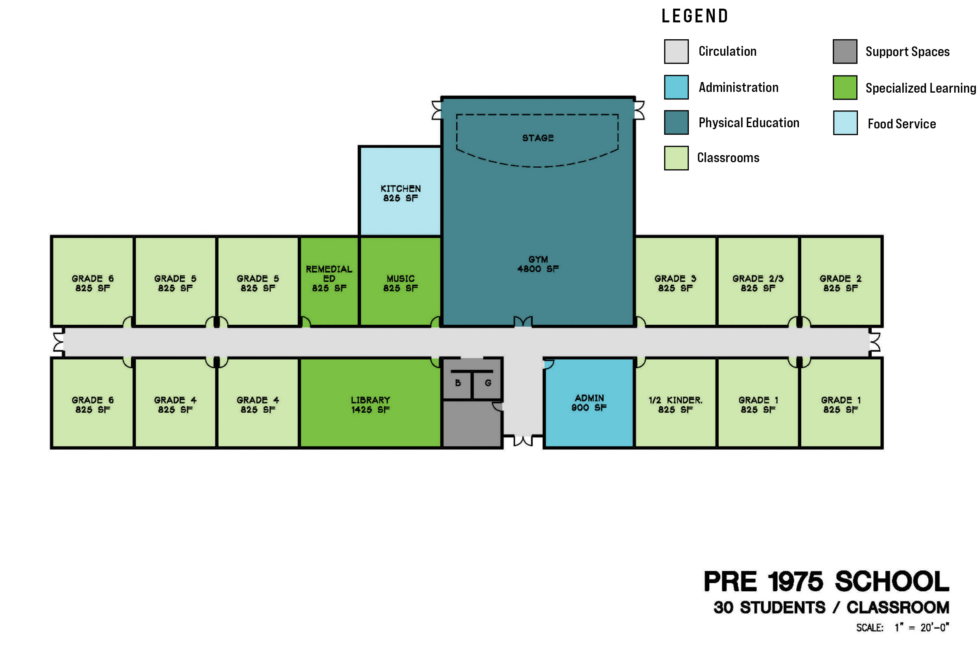
EVOLVING SCHOOL SPACES

Slide 17
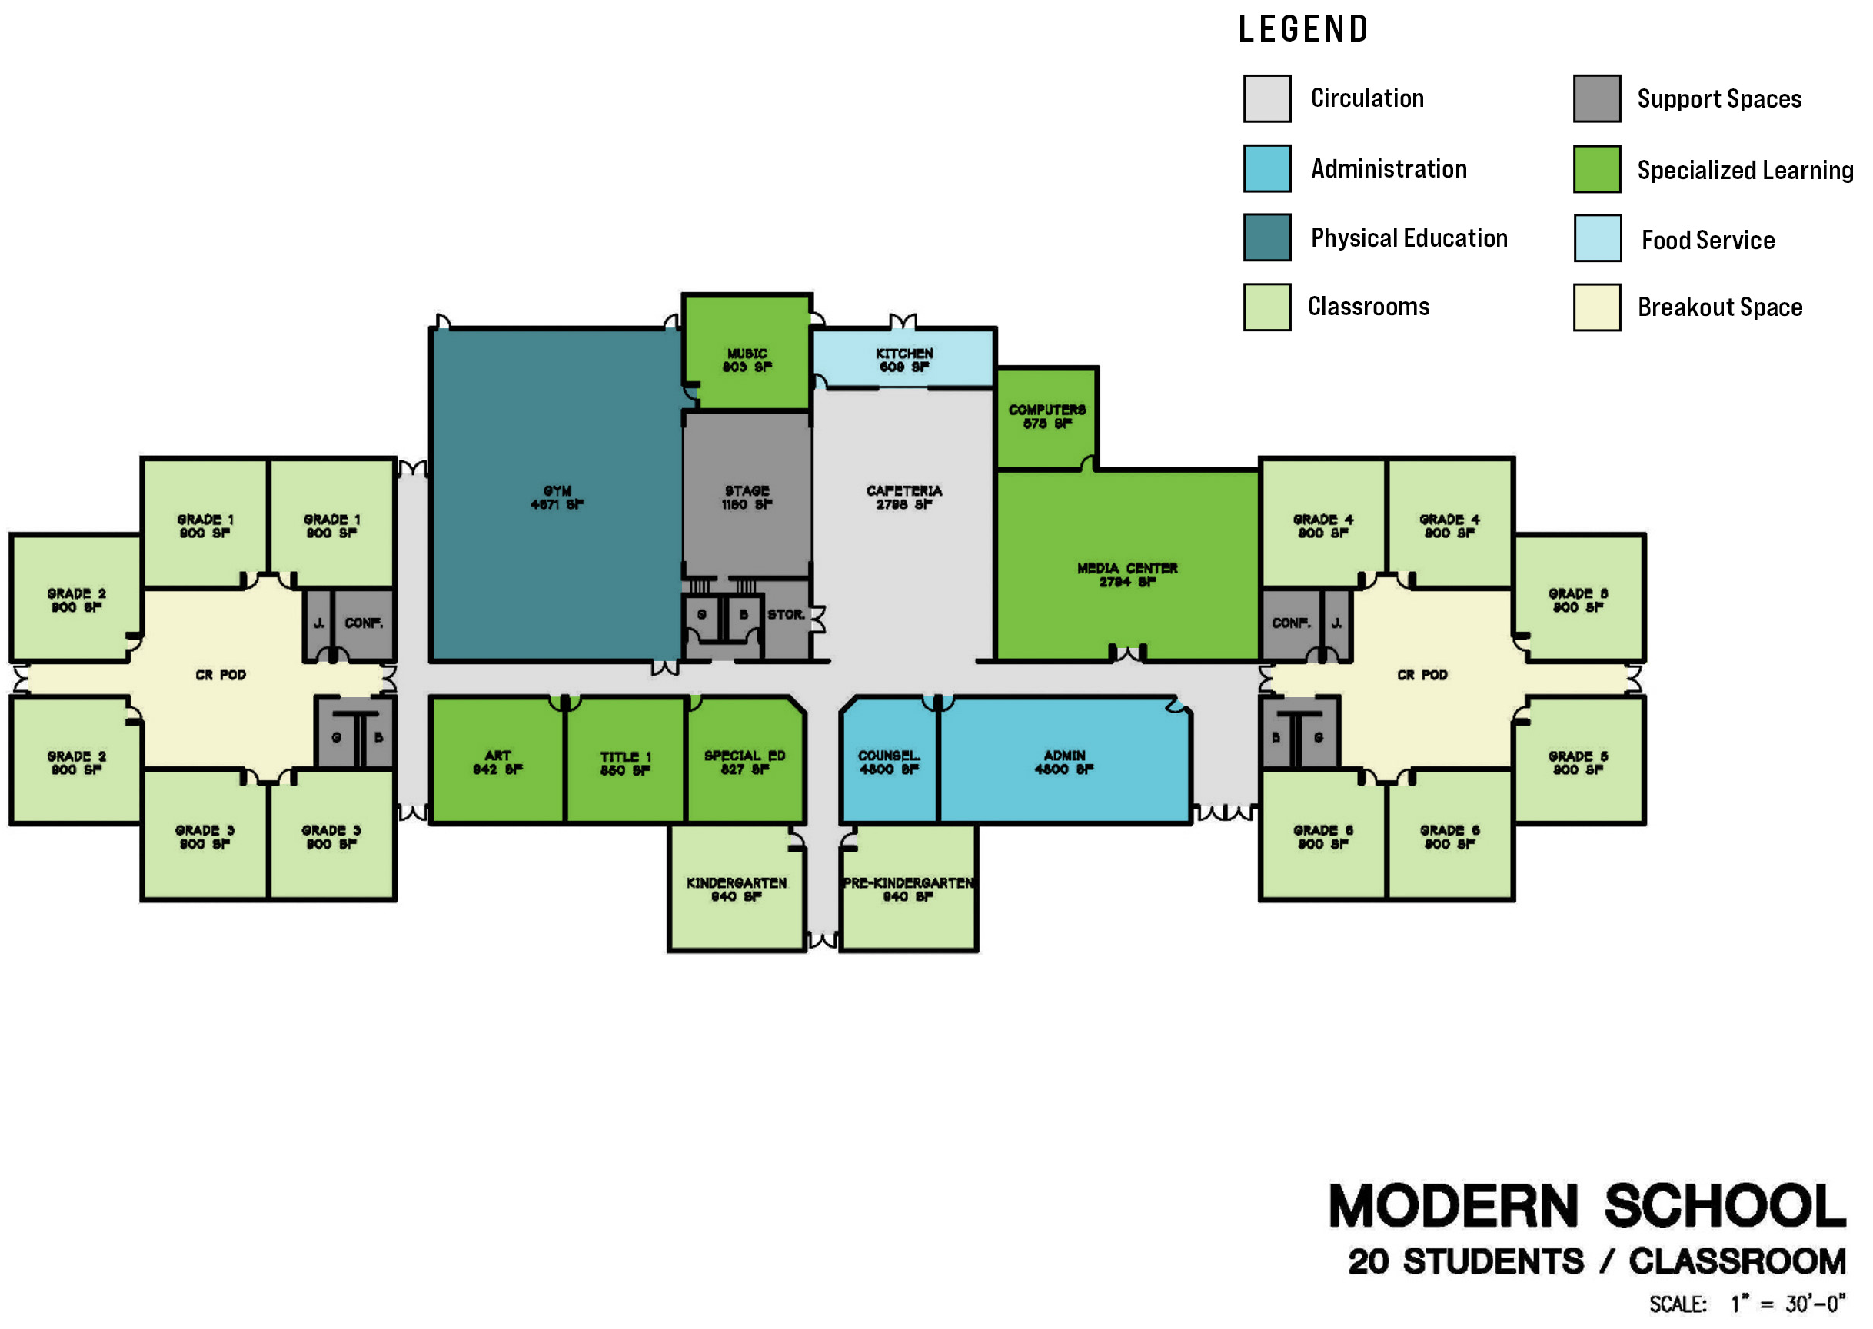
EVOLVING SCHOOL SPACES

Slide 18
ENROLLMENT PROJECTIONS
Percentage Increase Model
Regression Model
Cohort Survival Model – Linear Regression K
Cohort Survival Model – Natality K
Students per Housing Unit

Slide 19
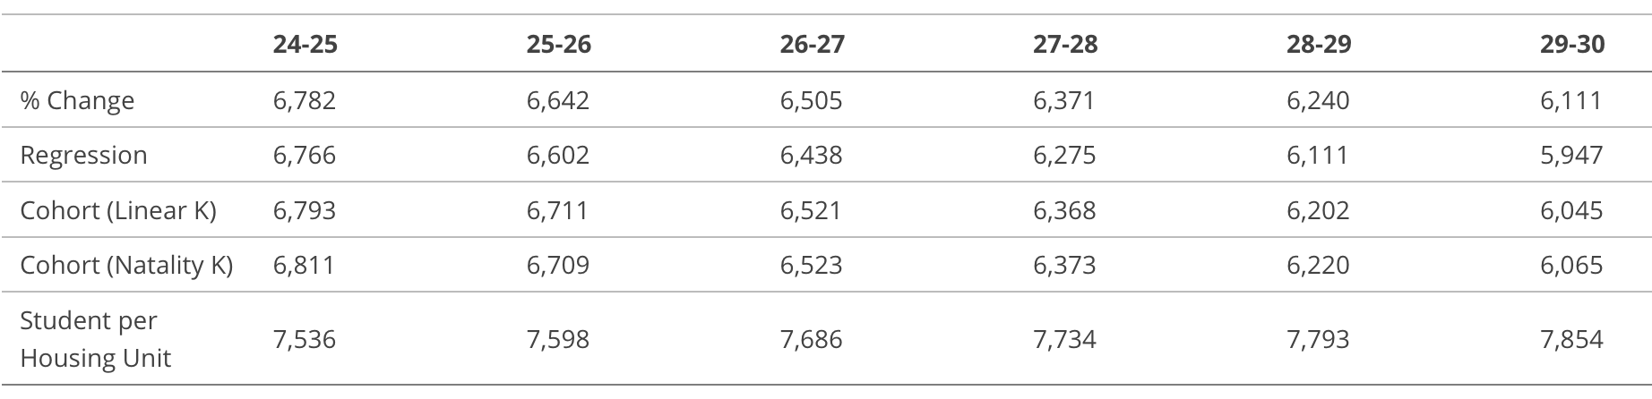
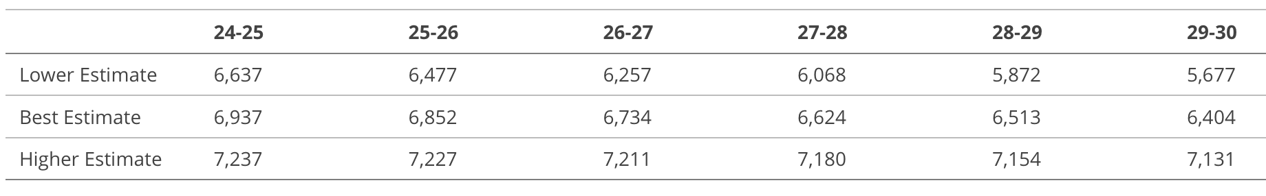
ENROLLMENT PROJECTIONS

Slide 20
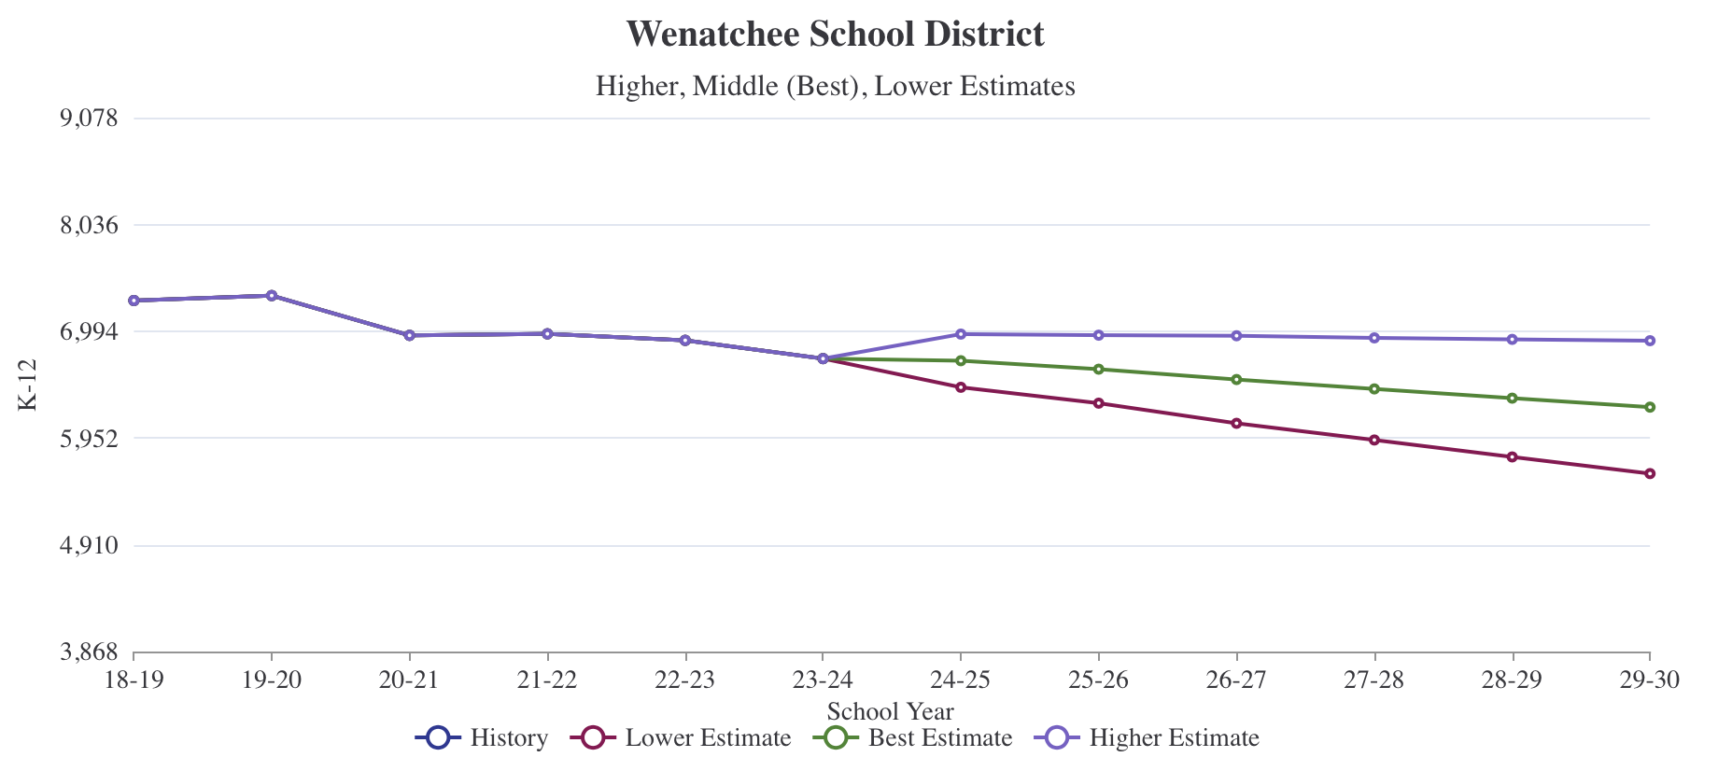
ENROLLMENT PROJECTIONS
K-12

Slide 21
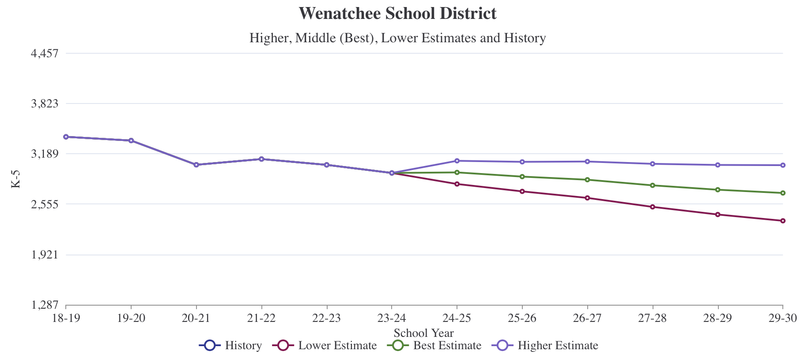
ENROLLMENT PROJECTIONS
K-5

Slide 22
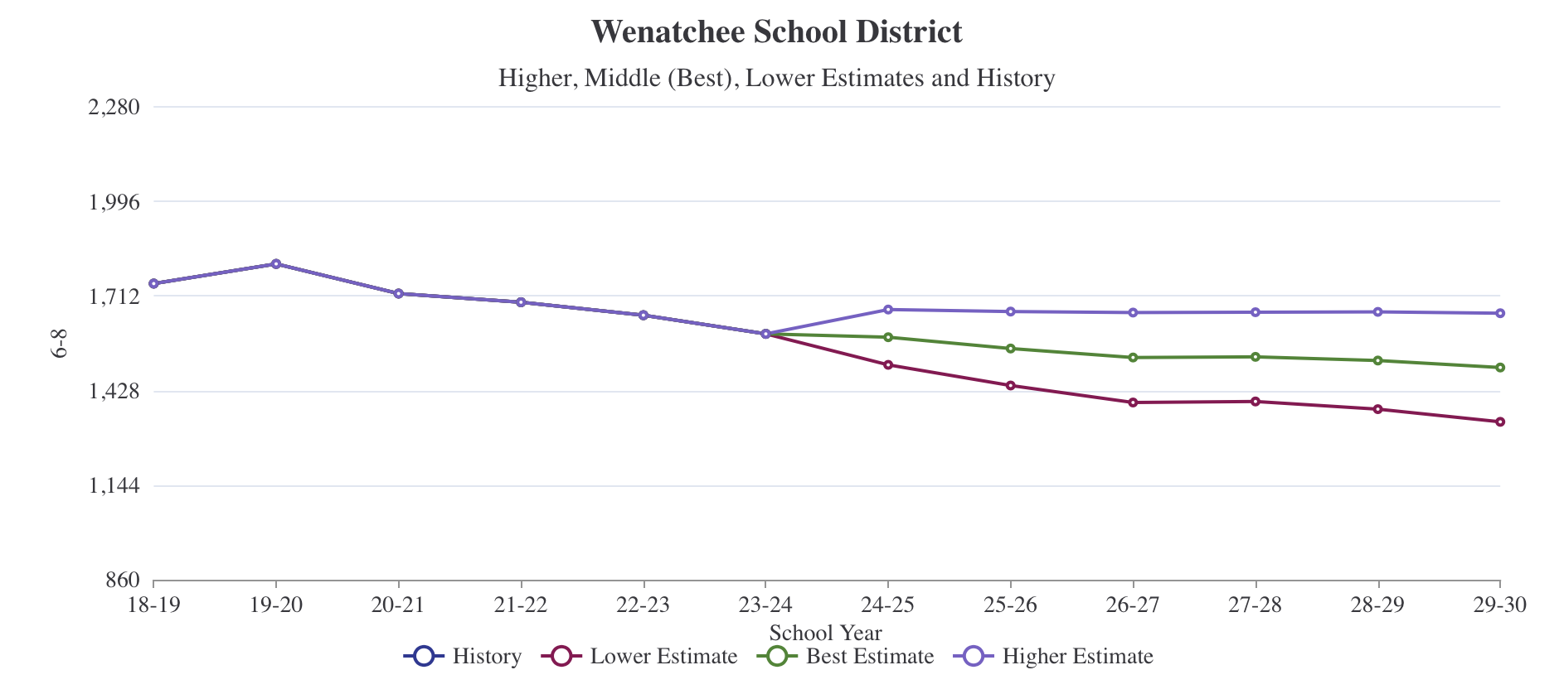
ENROLLMENT PROJECTIONS
6-8

Slide 23
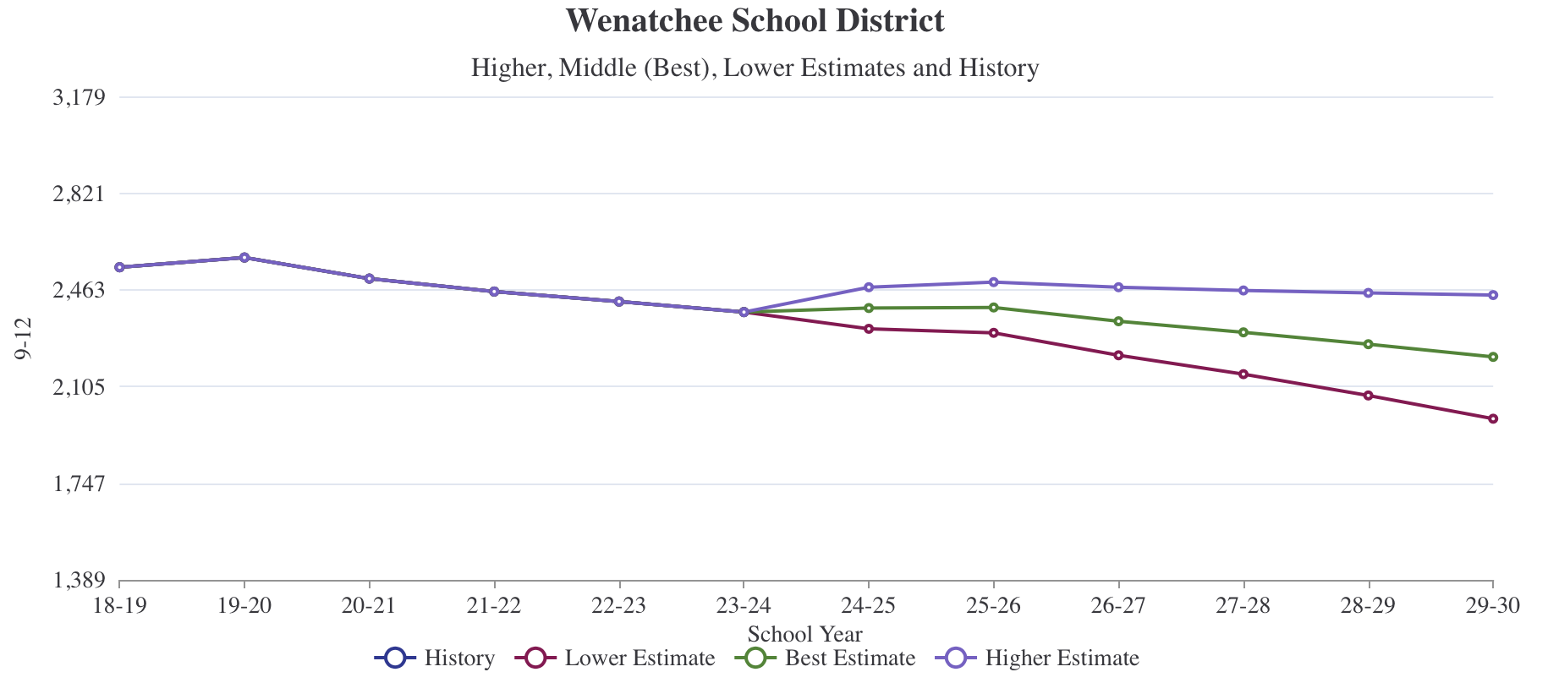
ENROLLMENT PROJECTIONS
9-12

Slide 24
PROGRAMMATIC CLASS SIZE STANDARDS
ELEMENTARY SCHOOL
TK (all day) / PreK (1/2 day) | 15
K - Full Day (FTE) | 20
Grade 1 | 22
Grade 2 | 22
Grade 3 | 24
Grade 4 | 26
Grade 5 | 26
Music | 0
PE | 0
Library | 0
Art | 0
Self Cont. Sp Ed | 9
RR, Title I, or Other Pull Out | 0

Slide 25
PROGRAMMATIC CLASS SIZE STANDARDS
MIDDLE SCHOOL
Grades 6 | 27
Grades 7-8 | 27
Art | 27
Music | 27
PE | 27
Science | 27
CTE | 24
Self Cont. Sp Ed | 9
RR, Title I, or Other Pull Out | 0

Slide 26
CLASS SIZE STANDARDS
HIGH SCHOOL
Grades 9-12 | 27
Art | 27
Music | 27
PE | 27
Science | 27
CTE | 24
Self Cont. Sp Ed | 9
RR, Title I, or Other Pull Out | 0

Slide 27
SCHOOL CAPACITY CALCULATION ELEMENTARY - EXAMPLE
JOHN NEWBERY ELEMENTARY
Room Name | # Rooms | Room Capacity | Subtotal Capacity
TK/PreK | 0 | 30 | -
K Full Day | 3 | 20 | 60
Grade 1 | 4 | 22 | 88
Grade 2 | 4 | 22 | 88
Grade 3 | 3 | 24 | 72
Grade 4 | 3 | 26 | 78
Grade 5 | 3 | 26 | 78
Art | 1 | 0 | -
Music | 1 | 0 | -
PE | 1 | 0 | -
Library | 1 | 0 | -
Self Cont. Sp Ed | 1 | 9 | 9
RR, Title I, Pull Out | 0 (+3) | 0 | -
Enrichment | 0 (+1) | 0 | -
Total Room Count | 23 |  | 473
IF² (Imperfect Fit Factor) |  |  | 95%
Permanent Programmatic Capacity* |  |  | 449
* Permanent Capacity does not include portable classrooms

Slide 28
SCHOOL CAPACITY CALCULATION
K-5 ELEMENTARY SCHOOLS
ALL ELEMENTARY
Room Name | # Rooms | Room Capacity | Subtotal Capacity
TK/PreK | 3 | 30 | 90
K Full Day | 20 | 20 | 400
Grade 1 | 25 | 22 | 550
Grade 2 | 23 | 22 | 506
Grade 3 | 19 | 24 | 456
Grade 4 | 20 | 26 | 520
Grade 5 | 20 | 26 | 520
Art | 7 | 0 | -
Music | 8 | 0 | -
PE | 8 | 0 | -
Library | 7 | 0 | -
Self Cont. Sp Ed | 3 | 9 | 27
RR, Title I, Pull Out | 10 | 0 | -
Enrichment | 6 | 0 | -
Total Room Count | 176 |  | 2,979
IF² (Imperfect Fit Factor) |  |  | 95%
Permanent Capacity* |  |  | 2,830
* Permanent Capacity does not include portable classrooms

Slide 29
K-5 CAPACITY vs. ENROLLMENT ELEMENTARY SCHOOLS

Slide 30
SCHOOL CAPACITY CALCULATION
MIDDLE SCHOOLS
ALL MIDDLE SCHOOLS
Room Name | # Rooms | Room Capacity | Subtotal Capacity
Grades 6-8 General + Science | 64 | 27 | 1,620
Art | 3 | 27 | 81
Music | 7 | 27 | 189
PE | 6 | 27 | 162
CTE | 6 | 24 | 144
Self Cont. Sp Ed | 1 | 9 | 9
RR/T-1 Pull Out | 18 | 0 | -
Total Room Count | 37 |  | 2,205
Scheduling Factor |  |  | 83%
IF² (Imperfect Fit Factor) |  |  | 95%
Permanent Capacity* |  |  | 1,739
* Permanent Capacity does not include portable classrooms
A scheduling factor of 83% = classroom is scheduled 5 of 6 periods

Slide 31
CAPACITY vs. ENROLLMENT
MIDDLE SCHOOL

Slide 32
SCHOOL CAPACITY CALCULATION
HIGH SCHOOL
WENATCHEE HIGH SCHOOL
Room Name | # Rooms | Room Capacity | Subtotal Capacity
Grades 9-12 General + Science | 54 | 27 | 1,539
Art | 3 | 27 | 108
Music | 4 | 27 | 108
PE | 6 | 27 | 189
CTE | 21 | 24 | 504
ALE | 7 | 15 | 105
Self Cont. Sp Ed | 1 | 9 | 9
RR/T-1 Pull Out | 1 | 0 | -
Total Room Count | 97 |  | 2,427
Scheduling Factor |  |  | 86%
IF² (Imperfect Fit Factor) |  |  | 95%
Permanent Capacity* |  |  | 1,983
* Permanent Capacity does not include portable classrooms
A scheduling factor of 86% = classroom is scheduled 6 of 7 periods

Slide 33
CAPACITY vs. ENROLLMENT
HIGH SCHOOL

Slide 34
UTILIZATION =
ENROLLMENT ÷ CAPACITY
School | Permanent Capacity | 2024 Enrollment | Capacity Surplus (Deficit) | Current Utilization | Projected Enrollment 2029-30 | Projected Utilization 2029-30
Elementary Total | 3,302 | 2,839 | 193 | 94% | 2,694 | 89%
Orchard Middle School | 530 | 415 | 115 | 78%
Pioneer Middle School | 686 | 530 | 156 | 77%
Foothills Middle School | 615 | 590 | (60) | 96%
Middle School Total | 1,831 | 1,535 | 211 | 84% | 1,497 | 82%
Wenatchee High School | 1,983 | 2,056 | (77) | 104%
Westside High School* | 217 | 185 | 32 | 85%
High School Total | 2,200 | 2,241 | (41) | 102% | 2,215 | 101%
Castle Rock Early Learning Ctr | 189 | 150 | 39 | 79%
Valley Academy K-8 | 192 | 221 | (29) | 115%
Other School Total
District Total | 7,333 | 6,615 | 718 | 90% | 6,404 | 87%
*Permanent Capacity does not include portable classrooms EXCEPT at Westside High School
Notes:
Middle Schools = 6 Period Day
WHS = 7 Period Day
WSHS = 5 Period Day
7174 ospi / 6925 k12enroll – diff of 310

Slide 35
BUILDING CONDITION - PHYSICAL
CLEAN ENERGY AUDIT PRIORITY
Schools Prioritized by need, return on investment opportunity and timeliness of action required.
1 | Wenatchee High School
2 | Foothills Middle School Orchard Middle School Pioneer Middle School
3 | Castle Rock Early Learning Center Washington Elementary Columbia Elementary John Newbery Elementary Lewis & Clark Elementary Mission View Elementary Sunnyslope Elementary | Valley Academy K-8 Westside High School Wenatchee Valley Technical Skills Center

Slide 36
BUILDING CONDITION - PHYSICAL
Each system sub-score is “weighed” according to its proportional value to the building as a whole
95+ | Excellent: The building and/or a majority of its systems are in excellent condition and only require preventative maintenance
85-94 | Good: The building and/or a majority of its systems are in good condition and only require routine maintenance.
62-84 | Fair: The building and/or some of its systems are in fair condition and require minor repair.
30-61 | Poor: The building and/or a significant number of its systems are in poor condition and require major repair or renovation.
Below 30 | Unsatisfactory: The building and/or a majority of its systems should be considered for replacement.

Slide 37
BUILDING CONDITION - PHYSICAL
School | Physical Condition Score | Physical Condition Description | Clean Energy Audit
Castle Rock Early Learning Ctr | n/a | n/a | 3
Washington Elementary | 97.95 | Excellent | 3
Columbia Elementary | 65.46 | Fair | 3
John Newbery Elementary | 73.33 | Fair | 3
Lewis & Clark Elementary | 59.22 | Poor | 3
Lincoln Elementary | 98.54 | Excellent | 3
Mission View Elementary | 57.37 | Poor | 3
Sunnyslope Elementary | 87.22 | Good | 3
Valley Academy K-8 | 68.75 | Fair | 3

Slide 38
BUILDING CONDITION - PHYSICAL
School | Physical Condition Score | Physical Condition Description | Clean Energy Audit
Foothills Middle School | 72.58 | Fair | 2
Orchard Middle School | 84.12 | Fair | 2
Pioneer Middle School – Gym | 60.34 | Poor | 2
Pioneer Middle School – Main | 91.90 | Good | 2
Wenatchee High School | 49.65 | Poor | 1
Westside High School - Main | 96.66 | Excellent | 3
Westside High School – Fitness | 89.51 | Good | 3

Slide 39
BUILDING CONDITION - FUNCTIONAL
Space sizes, adjacencies, utilities, surfaces, daylight, access, fixed equipment, and storage
The program, or “school”, is assessed as a unit
90+ | Good: The facility design supports the educational program offered. It may have minor functional adequacy problems but generally meets the needs of the educational program.
75-89 | Fair: The facility has some problems meeting the needs of the educational program and may require some improvements.
50-74 | Poor: The facility has numerous problems meeting the needs of the educational program and needs significant improvements.
Below 50 | Unsatisfactory: The facility is functionally inadequate and does not support the educational program in many areas.

Slide 40
BUILDING CONDITION - FUNCTIONAL
School | Functional Adequacy Score | Functional Adequacy Description
Castle Rock Early Learning Ctr | 99 | Good
Washington Elementary | 88 | Fair
Columbia Elementary | 80 | Fair
John Newbery Elementary | 78 | Fair
Lewis & Clark Elementary | 79 | Fair
Lincoln Elementary | 94 | Good
Mission View Elementary | 69 | Poor
Sunnyslope Elementary | 89 | Fair
Valley Academy K-8 | 51 | Poor

Slide 41
BUILDING CONDITION - FUNCTIONAL
School | Functional Adequacy Score | Functional Adequacy Description
Foothills Middle School | 76 | Fair
Orchard Middle School | 92 | Good
Pioneer Middle School | 95 | Good
Wenatchee High School | 88 | Fair
Westside High School | 58 | Poor
Wenatchee Valley Technical Skills Center | 97 | Good

Slide 42
COMBINED DATA
School | Permanent Capacity* | Current Utilization w/o Portables | Projected Utilization 2029-30 | Physical Condition Description | Clean Energy Audit Priority | Functional Adequacy Description
Washington Elementary | 497 | 95% |  | Excellent | 3 | Fair
Columbia Elementary | 384 | 91% |  | Fair | 3 | Fair
John Newbery Elementary | 449 | 95% |  | Fair | 3 | Fair
Lewis & Clark Elementary | 428 | 94% |  | Poor | 3 | Fair
Lincoln Elementary | 531 | 85% |  | Excellent | 3 | Good
Mission View Elementary | 448 | 97% |  | Poor | 3 | Poor
Sunnyslope Elementary | 295 | 102% |  | Good | 3 | Fair
Elementary Total | 3,302 | 94% | 89%

Slide 43
COMBINED DATA
School | Permanent Capacity | Current Utilization w/o Portables | Projected Utilization 2029-30 | Physical Condition Description | Clean Energy Audit Priority | Functional Adequacy Description
Elementary Total | 3,302 | 94% | 89%
Orchard Middle School | 530 | 78% |  | Fair | 2 | Fair
Pioneer Middle School | 686 | 77% |  | Fair | 2 | Good
Foothills Middle School (Gym/Main) | 615 | 96% |  | Poor / Good | 2 | Good
Middle School Total | 1,831 | 84% | 82%
Wenatchee High School | 1,983 | 104% |  | Poor | 1 | Fair
Westside High School (Main/Fit)* | 217 | 85% |  | Excellent / Good | 3 | Poor
High School Total | 2,200 | 102% | 101%
Castle Rock Early Learning Ctr | 189 | 79% |  | n/a | 3 | Good
Valley Academy K-8 | 192 | 115% |  | Fair | 3 | Poor
Other School Total | n/a | n/a | n/a
District Total | 7,333 | 93% | 87%
*Permanent Capacity does not include portable classrooms EXCEPT at Westside High School

Slide 44
INITIAL FINDINGS
ENROLLMENT
Over the last six years Elementary enrollment has dropped by 455 students
The district has realized a consistent annual drop in all years except for 2021 where elementary students returned to school after COVID
Projections for the next six years indicate continual annual reductions in the number of elementary students enrolled in the district

Slide 45
INITIAL FINDINGS
ENROLLMENT
For the last five years Middle School and High School enrollment has dropped every year.
Middle School enrollment is 210 students lower than in 2018.
High School enrollment is 202 students lower than in 2018.
Projections for the next six years indicate continual annual reductions in the number of Middle and High School students enrolled in the district.

Slide 46
INITIAL FINDINGS
CAPACITY & UTILIZATION
Elementary utilization is above permanent capacity, though many schools have portables which mitigate the impact.
Elementary utilization will drop below capacity within the next two years – this is true even when portable classrooms are not included in the capacity calculations.

Slide 47
INITIAL FINDINGS
CAPACITY & UTILIZATION
Middle School enrollment is below capacity at all schools and is projected to continue to fall below building capacity over the next six years.
WHS utilization is above capacity and the school is addressing this through the use of portable classrooms. Utilization is projected drop below capacity is six to seven years.
Westside High School utilization is below capacity portable classrooms considered part of the capacity calculation at this school.

Slide 48
INITIAL FINDINGS
CAPACITY & UTILIZATION
Castle Rock Early Learning Center’s utilization is under their capacity and expected to remain so into the coming years.
Valley Academy’s utilization exceeds the building’s capacity. This is mitigated by the fact that not all students attend the school for the full day or at the same time. There is a waiting list for this school.

Slide 49
INITIAL FINDINGS
PHYSICAL CONDITION
Two Elementary Schools scored Excellent, one scored Good and two scored Fair. Two schools, Lewis & Clark and Mission View, were scored as Poor. All Elementary Schools are considered Priority 3 for the Clean Energy Audit.
Two Middle Schools scored Fair. The gym at Foothills was scored as Poor, while the main building was scored as Good. All Middle Schools are considered Priority 2 for the Clean Energy Audit.

Slide 50
INITIAL FINDINGS
PHYSICAL CONDITION
Wenatchee High School was scored as Poor and as a Priority 1 for the Clean Energy Audit. Westside High School’s main building was scored Excellent while the Fitness building was scored as Good. It is considered Priority 2 for the Clean Energy Audit
Castle Rock ELC was not evaluated, and is considered Priority 3 for the Clean Energy Audit.
Valley Academy was scored as Fair and is considered Priority 3 for the Clean Energy Audit.

Slide 51
INITIAL FINDINGS
FUNCTIONAL ADEQUACY
All elementary schools were scored as Fair except for Lincoln which was scored as Good and Mission View which was scored as Poor.
Orchard Middle School was scored as Fair while the other two Middle Schools were scored as Good.
Wenatchee High School was scored as Fair, while Westside High School was scored as Poor. WSHS’s score was primarily due to programs being delivered in portable classrooms and classroom siting issues.

Slide 52
INITIAL FINDINGS
FUNCTIONAL ADEQUACY
Castle Rock ELC was scored as Good.
Valley Academy was scored as Poor due to a number of issues related to the school being in a converted space.

Slide 53

QUESTIONS - CLARIFICATIONS

Slide 54
DATA COLLECTION + NEXT MEETING
Please take 10 minutes (max) and complete the short data collection
Please deposit near the door so all answers remain anonymous.
Summary responses will be presented back to the committee at our April meeting to use alongside the other data presented.
Next Meeting: April 16th from 6:00pm - 7:30pm

